Slide 1


Unleashing the Power of Virtual Assistants: Generating Human-like Responses to Natural Language Inputs and Transcribing
By team edwin
Justine biju paul,
NISSA ANN SAJI
ajas Mathew,
Akhil sajan Mathew,
Fardeen saly

Slide 2
Introducing Your Personal Virtual Assistant
Introduction
The Need for a Virtual Assistant
Problem We Tackled
How It Works
Key Features
Main Words for it to Recognizes

Slide 3
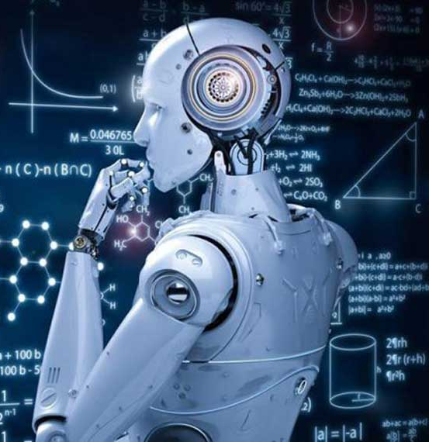
Introducing Your Personal Virtual Assistant EDWIN
Imagine a personal assistant powered by cutting-edge technology.
Edwin offers human-like responses to natural language inputs.
It enhances efficiency, helping you get things done faster.

Slide 4

The Need for a Virtual Assistant
A virtual assistant bridges the gap, providing human-like responses to results computed by machine.
Edwin helps people who knows only the mother tongue which helps them to access him and understand the results.
Enables effective communication regardless of location, thick accent or languages.

Slide 5
Problem We Tackled
PROBLEM STATEMENT:
Speech to text transcription for Indian languages. The problem entails transcription in the native script and then translation to English. The languages of interest are Hindi, Indian English, Urdu, Bengali, Punjabi.
DESCRIPTION:
The problem entails transcription of audio files to the native script of the audio and then translation to English. The languages of interest are as mentioned below. A key element to be considered is that the solution would be required to be tuned for Indian accents. The languages of interest for the problem statement are shown below: Hindi, Indian English, Urdu‚ Bengali, Punjabi Datasets pertaining to theses languages will be provided by us, which will consist of two major chunks of data: Training Set and a hidden test set. The participants will have only access to the Training set. They will develop their solutions based on the Training set. After the final solution submission by the participants, the final hackathon rankings will be decided by evaluation on the hidden test set. This is done to ensure that the participants solutions generalize better on newer data. The evaluation metric we want to use for this hackathon will be Word Error Rate (WER). The WER will be computed between the actual translated text with the solution generated text. The lower the WER the better the model.
PROBLEM STATEMENT: 1456

Slide 6

How It Works
Utilizes natural language processing, machine learning, and neural networks.
Analysis user inputs to identify intent and generate context-specific responses.
Employs deep neural networks trained on vast data for human-like accuracy.
Constantly learns and improves from user interactions.
Whisper AI which is more efficient and accurate to transcribe and translate.

Slide 7

Key Features
Advanced natural language processing for human-like interactions.
Personalized experience through learning from user interactions.
It uses advance technology like ChatGPT and Whisper by OpenAI to get more accurate results and also content specific.
It will transcribe and translate any audio format to English, Hindi, Urdu, and many more language.

Slide 8
Main Words for it to Recognizes
To open sites:-
use "site" as keyword before or after website name for given websites-
Open AI, Facebook, Blogger, LinkedIn, Apple, WordPress, Microsoft, Mozilla, Cloudflare, Adobe, Europa, Amazon, GitHub, Samsung, Google, Wikipedia
To play music:-
use "play music", "play song" or "open Spotify" as keyword

Slide 9
To get written document use keyword "using artificial intelligence“.
To open YouTube use "YouTube" as keyword before or after the thing you want to search.
To open vs code use "open code" as keyword.
To get time use "time" as keyword.
To exit use "stop" or "exit" as keyword.
To ask questions wait for 2 seconds and ask.

Slide 10
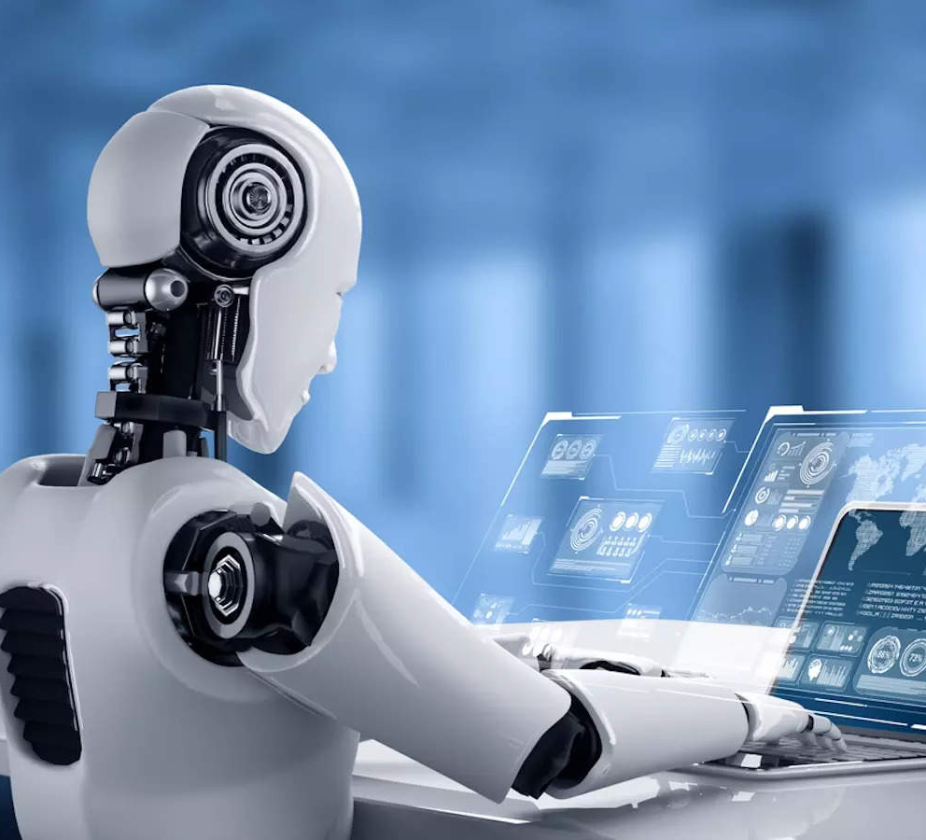
THANK YOU
BY TEAM EDWIN
JUSTINE BIJU PAUL,
AJAS MATHEW,
NISSA ANN SAJI
AKHIL SAJAN MATHEW,
FARDEEN SALY

